Slide 1
Health service
Presented By-
Sulekha
1 April 2019

Slide 2
Problem statement
Health service system is an application which helps user to search nearest diagnostic center and user can book online appointment for health service.

Slide 3
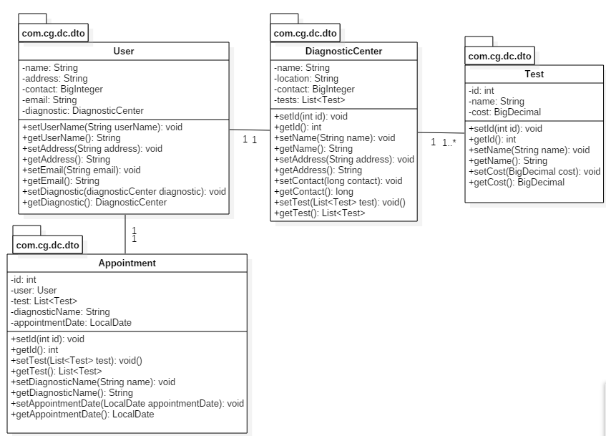
DTO classes

Slide 4
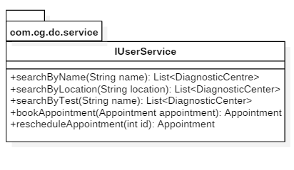
Service Interface

Slide 5
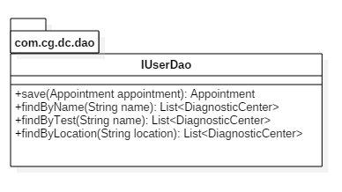
Dao Interfaces

Slide 6
Thank you

